Slide 1

Title : Ai-Powered Career Recommendation System
BATCH-NO : 10
Project Co-Ordinators :
Mrs.C.SUBALAKSHMI ,
Dr.T.KUMANAN
Team Members :
P.BALAJI-221061101202,
P.VINAY KUMAR-221061101202,
P.MUNI SAI-221061101215.

Slide 2

Ai-Powered Career Recommendation
System

Slide 3
Table Of Contents :
Abstarct
Introduction
Key features using Ai-Powered Career Recommendation system
Literature Survey
Existing System
Proposed System
Software Requirements
Conclusion

Slide 4
ABSTRACT :
Overview of the career recommendation system , Aim to provide personalized career suggestions based on user profiles.
Data collection :
collect user data through questionnaires and resumes.
Personalize suggestions based on users-specific data.
Extraxt relavant information like skills,interests,qualifications.
Key Words :
Recommendation system,Python,ML,NLP.

Slide 5
INTRODUCTION
An AI-powered career recommendation system, built using Python with machine learning (ML) and natural language processing (NLP) capabilities
Machine Learning (ML) is the backbone of the recommendation system. It uses algorithms to learn from historical data and make predictions about which career paths would be most suitable for a given user.
Natural Language Processing (NLP) plays a crucial role in understanding the textual information available in resumes, job postings, and user profiles

Slide 6

KEY FEATURES OF
CAREER RECOMMENDATION SYSTEM
Tailored recommendations based on individual skills, interests, and aspirations.
Personalized Career Advice
Analysis of user profiles to provide customized career
paths.
Machine Learning Algorithms
Use of advanced algorithms to predict suitable career options.
Continuous learning from user interactions to improve accuracy.

Slide 7
LITERATURE REVIEW :
YEAR | AUTHOR | TITLE | MODULE | REMARKS
2021 | Gupta, A., & Sharma, S. | "AI-based Career Recommendation System for Job Seekers" | Machine Learning, Natural Language Processing | Focuses on using job seekers' resumes and job postings for personalized career recommendations.
2020 | Li, Z., Zhang, Y., & Zhou, X. | "Personalized Career Path Recommendation Using Deep Learning" | Deep Learning, Neural Networks, NLP | Emphasizes the use of deep learning for personalized career suggestions based on user data.
2019 | Sharma, R., & Gupta, P. | “Job Recommendation System Based on Skills and Preferences" | Machine Learning, Clustering, Content-based Filtering | Implements a system that clusters users based on skill sets and recommends jobs accordingly.
2018 | Chen, L., & Xu, H. | "Career Path Recommendation System Using Text Mining" | NLP, Text Mining, Collaborative Filtering | Focuses on text mining and collaborative filtering for analyzing job data and suggesting careers.

Slide 8
EXISTING SYSTEM :
Traditional career platforms like LinkedIn and job boards rely on outdated keyword-matching and rigid taxonomies, failing to capture evolving roles or nuanced skill combinations
For example : Python + data analysis for data science
Their recommendations are generic, biased, and poorly personalized, often reinforcing stereotypes.
Interfaces are cluttered, performance is slow, and they don’t help users identify or close skill gaps—only listing roles, not pathways to qualify for them.
Systems are slow due to inefficient backend architectures.
They fail to explain why roles are recommended.No guidance is given on how to bridge skill gaps.Overall, they offer limited value to modern job seekers.

Slide 9
PROPOSED SYSTEM :
Our career recommendation system uses advanced machine learning-TF-IDF and KNN-to understand skill combinations like "Python + SQL + statistics" for accurate role matching.
It identifies users' skill gaps and offers personalized guidance (e.g., recommending penetration testing for cybersecurity aspirants).
Built on a fast Flask backend, it delivers results in under 500ms with a clear, trust-building interface. Our curated dataset covers 21 emerging and hybrid roles, from AI ethics to DevRel. Bias mitigation ensures fair, inclusive suggestions.
Unlike static platforms, it evolves with the job market, guiding users not just to jobs, but toward achieving their career goals.
Features a *clear, actionable interface* that explains the reasoning behind each recommendation.

Slide 10
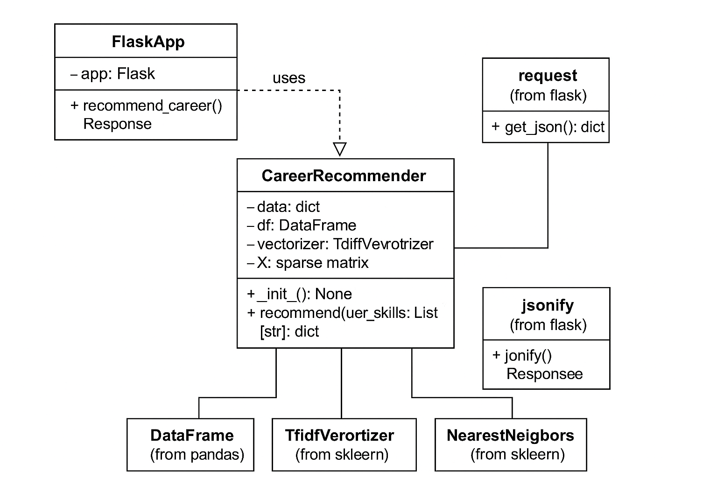
Class Diagram:
Input via Flask Web API:User sends a list of skills through a Post request.Flask uses request.get_json() to extract the skills.
Career Recommendation:Career Recommender transforms skills using TfidfVectorizer.Finds similar careers using Nearest Neighbors.
Output as JSON:The recommended careers are returned as a JSON response using jsonify().

Slide 11
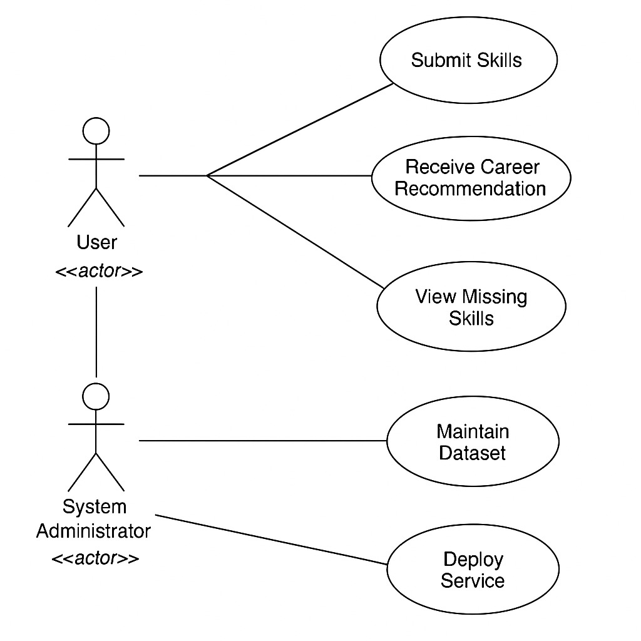
Use Case Diagram:
User Interactions
The user can submit skills to the system.Receive career Recommendations based on those skills.
System Administrator Roles
The System Administrator is responsible for: Maintaining the Dataset (e.g., updating or cleaning career data).Deploying the Service (making the system available to users).
Goal of the System
To help users identify career paths based on their current skills and to guide them on what skills they need to develop further.

Slide 12
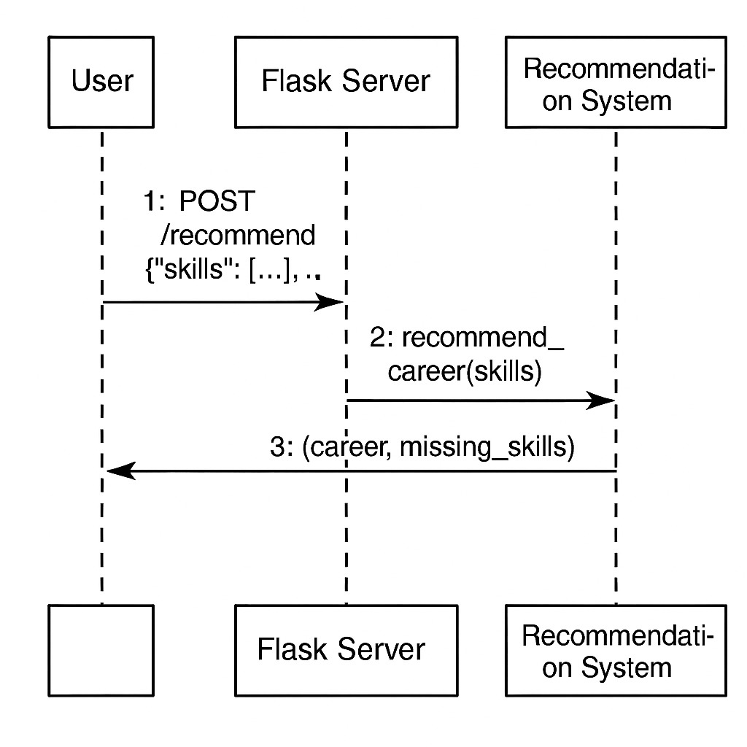
Sequence Diagram:
User Sends Request:
The user sends a POST request to /recommend with their list of skills in JSON format.
Flask Server Processes Request:
The Flask Server receives the request and calls recommend_career (skills) in the *Recommendation System
System Responds with Results:
The Recommendation System returns a career suggestion and a list of missing skills.The Flask Server sends this response back to the user.

Slide 13
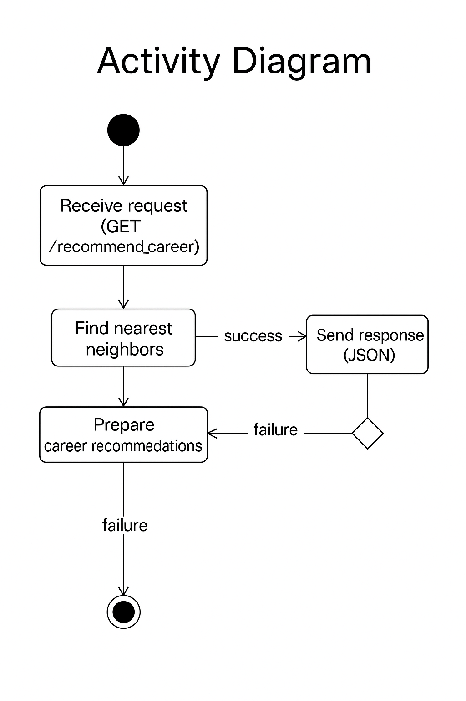
Activity Diagram:
Receive Request
The system receives a GET request at the /recommend_career endpoint. *
Process Request
It finds the nearest neighbors and prepares career recommendations.
If successful, it proceeds to send a response; if there's a failure, it handles it accordingly.
Send Response or End
On success, a JSON response is sent.On failure (at any stage), the process ends without sending a response.

Slide 14
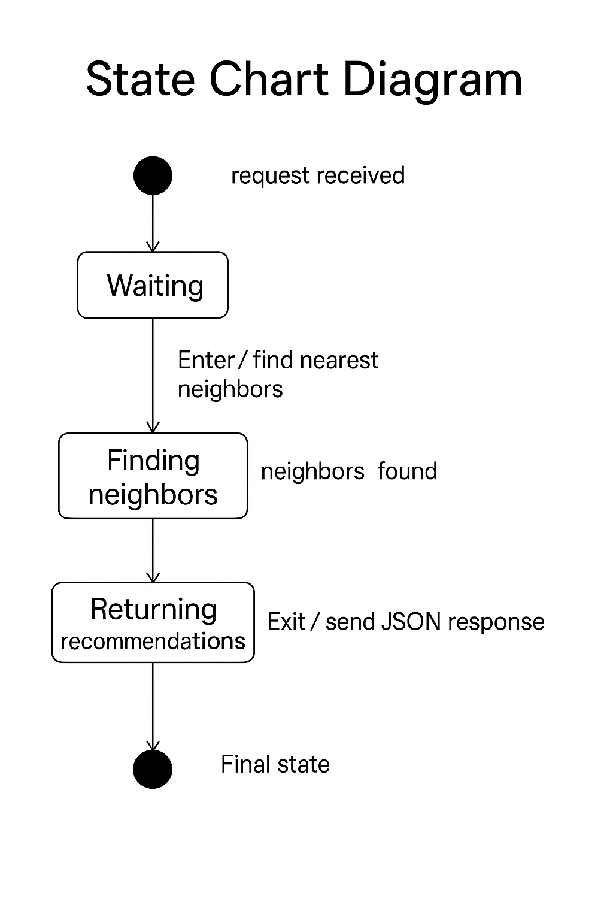
State Chart Diagram:
Waiting State: Triggered when a request is received. The system enters a waiting state to start processing.
Finding Neighbors: The system searches for nearest neighbors after entering this state.
Returning Recommendations: Once neighbors are found, the system returns career recommendations in JSON format and reaches the final state.

Slide 15
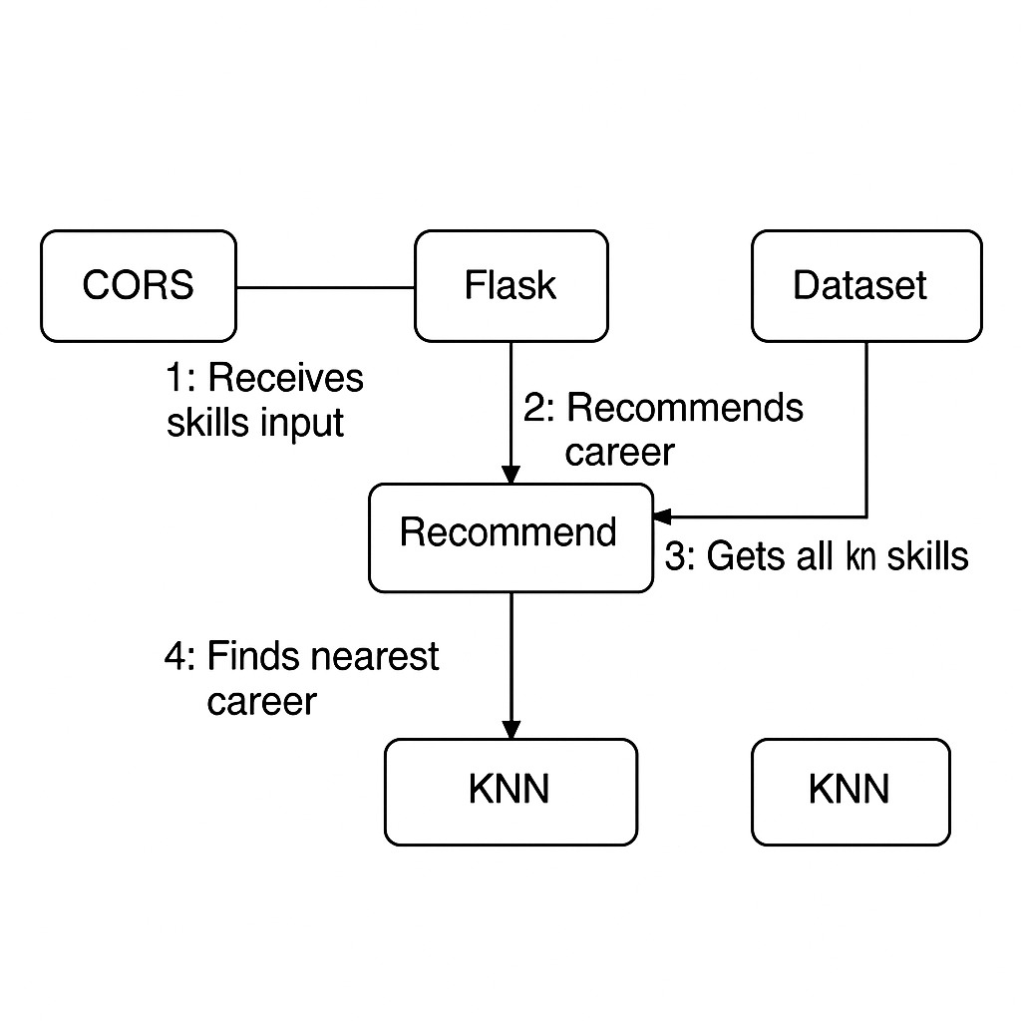
Collabration Diagram:
Input Received: CORS allows a client to send a skills input, which is received by a Flask backend
Processing Request: Flask calls the Recommend function, which queries the dataset to get known skills.
Generate Recommendation: The Recommend function uses the KNN (K-Nearest Neighbors) algorithm to find and return the nearest career match.

Slide 16
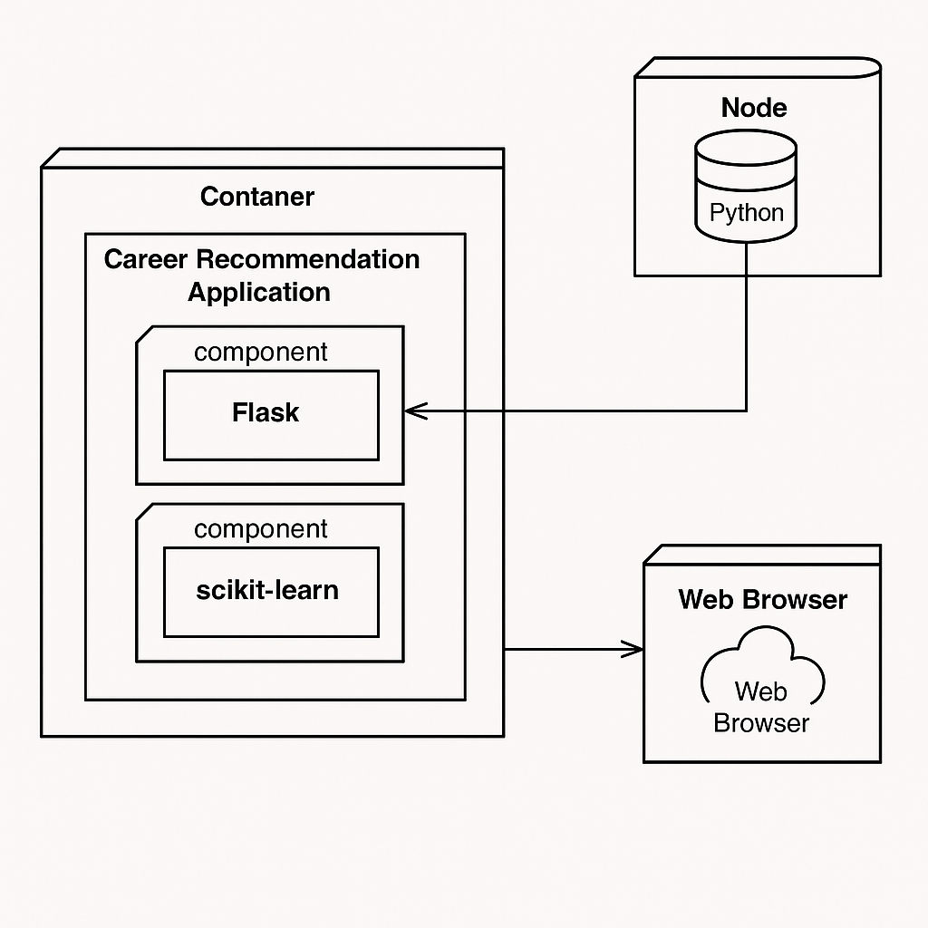
Deployment Diagram:
User Interaction The user interacts with the Web Browser to input skills or request recommendations
Backend Processing: The Career Recommendation Application: (inside a container) runs two main components: Flask(for handling requests and responses) ,scikit-learn (for executing the machine learning model)
Data Access and Communication: The application communicates with a Node containing Python logic/data (e.g., dataset or KNN model) to retrieve information and generate career recommendations.

Slide 17
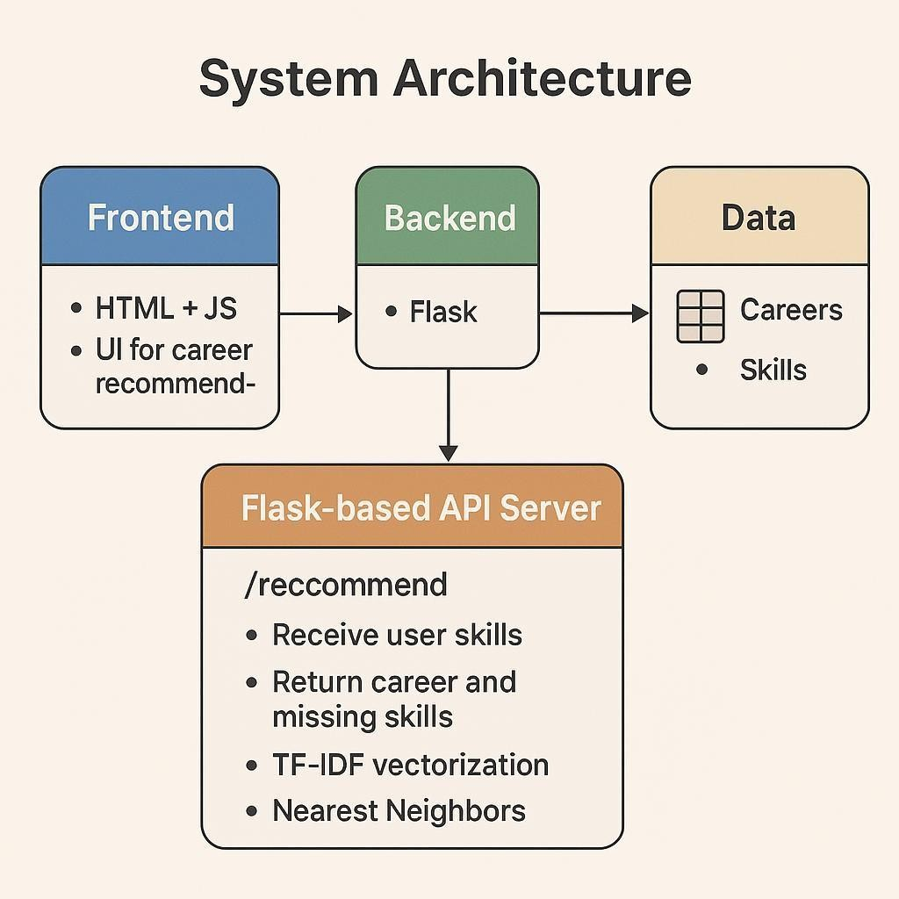
Architecture Diagram:
The system architecture for the Career Recommendation System includes three main components: the Frontend, Backend, and Data. The frontend is built using HTML and JavaScript, providing a user interface for inputting skills.
The backend uses Flask to handle requests and interact with the data, which contains information on careers and required skills.
A Flask-based API server processes skill input at the /recommend endpoint, performs TF-IDF vectorization, and applies the Nearest Neighbors algorithm to Suggest suitable careers and identify missing skills.

Slide 18
SOFTWARE REQUIREMENTS :
Frontend : Html,Css,Java Script.
Backend : Python, Machine Learning , Natural Learning Language.

Slide 19
CONCLUSION :
By leveraging machine learning algorithms, these systems can accurately predict potential career paths, identify skills gaps, and suggest actionable steps to achieve career goals.
This personalized approach not only enhances user experience but also fosters a deeper understanding of one's career trajectory, ultimately leading to more informed and fulfilling career decisions.

Slide 20


